Slide 1
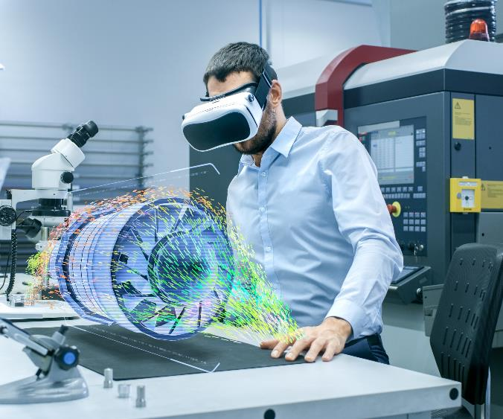
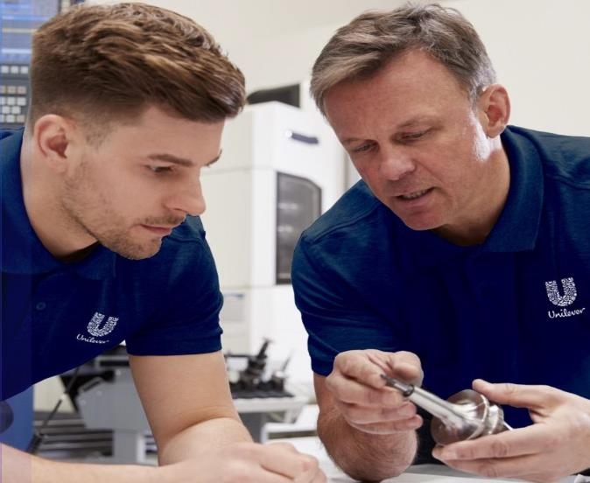
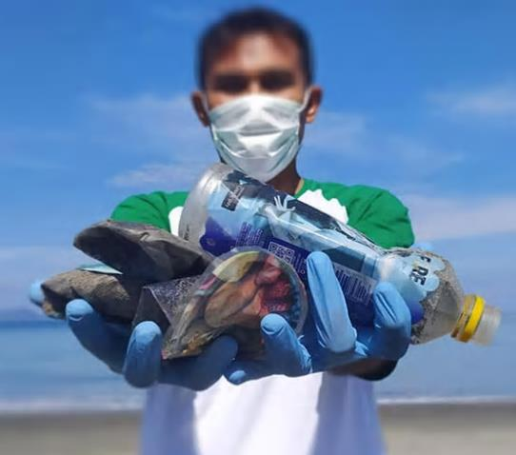
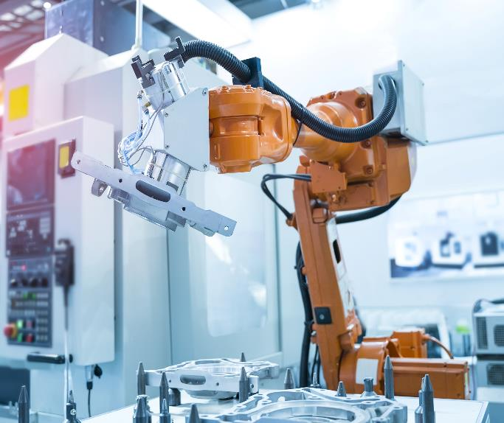
WE ARE UNILEVER ENGINEERS
GUARDIANS | CREATORS | PIONEERS
Notes:
Poster approach – white background with blocks (pictures)

Slide 2
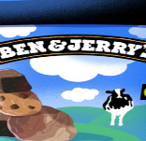
WELCOME
WELCOME TO ENGINEERING AT UNILEVER
ONE OF THE WORLD’S LARGEST CONSUMER GOODS COMPANIES
400+ HOUSEHOLD NAMES
Including brands like Ben and Jerry’s, Hellman’s and Dove. Enhancing the lives of 2.5 billion consumers everyday.
320+ FACTORIES GLOBALLY
Utilising the latest technology and innovations to produce sustainable products.
8000+ ENGINEERS
An ever-growing global connected community.
Skilled across multiple disciplines of engineering. Working together. Empowered to be the best Engineers they can be.

Slide 3
BE A PART OF A GLOBAL TEAM.
THE POSSIBILITIES ARE ENDLESS.​
When you join our team you won’t just be embarking on your next career step, you’ll be opening the door to opportunities that you never thought possible.
You’ll become part of our inclusive community of over 8000 of the most highly skilled Engineers in nearly every country in the world. Working together, supporting each other and sharing knowledge to build ground-breaking solutions.

Slide 4
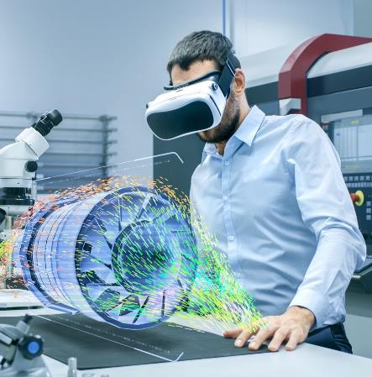
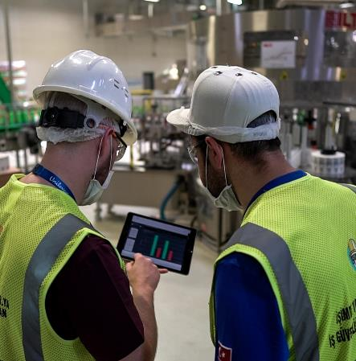
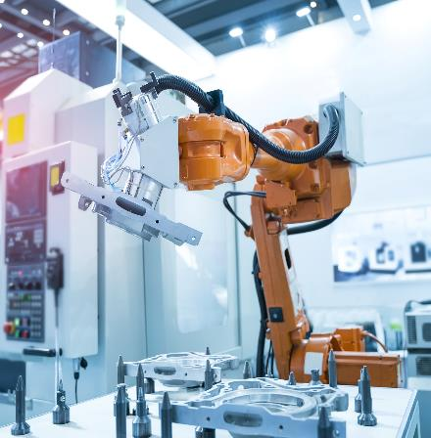
LOVE WORKING WITH NEW TECHNOLOGY?
BE PART OF BUILDING OUR FACTORIES OF THE FUTURE.​
We put technology at the forefront of everything we do. You’ll have all the data you need right at your fingertips to empower you to learn faster, work smarter and make better, more informed decisions.
Our factories aren’t just factories, they are factories of the future.
We have a world-class digital and robotics programme and as a Unilever Engineer, you’ll be directly implementing the latest technology to design and build solutions.

Slide 5
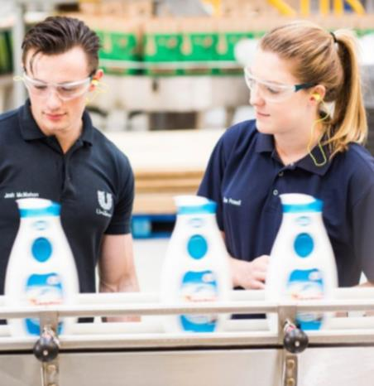
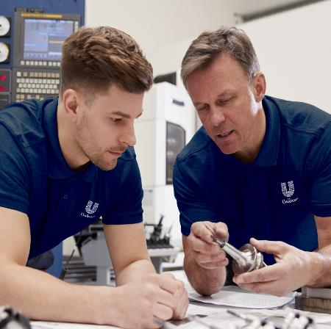
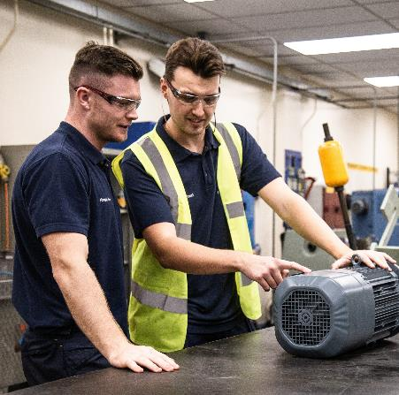
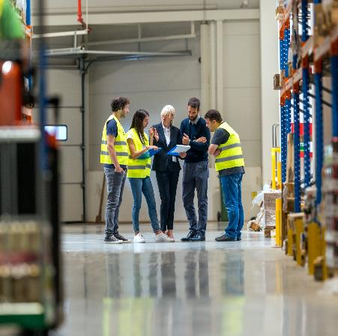
PASSIONATE ABOUT SOLVING PROBLEMS?
NEVER STOP DISCOVERING AT UNILEVER.
Our Unilever Engineers are future thinkers and we never stop learning. From Day One, you will embark on a journey of discovery that brings purpose to what you do. From being the guardians of our asset performance, to optimising supply chain processes, to creating fit for purpose designs, you will be creating solutions that deliver value.
In overcoming challenges, you will make things happen and as you grow and develop the work you do will not only have an impact right now, it will be laying a foundation for the future generation of Engineers.

Slide 6
WANT TO IMPACT THE LIVES OF CONSUMERS?
YOU WILL! EVERYDAY!
Small actions can make a big difference when your products are used everyday around the world by 2.5 billion consumers.
You’ll have the opportunity to directly impact their lives through household names like Ben and Jerry’s, Hellman’s and Dove.
Together, our Engineers touch every single product that Unilever produces and every piece of equipment in out factories around the world. As a Unilever Engineer, you will be enabling purposeful brands to grow’.

Slide 7
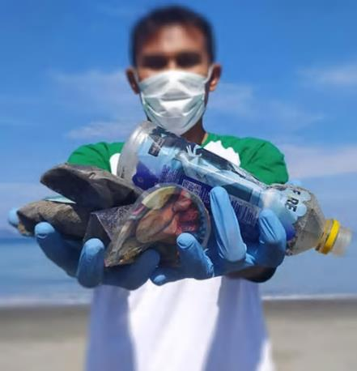
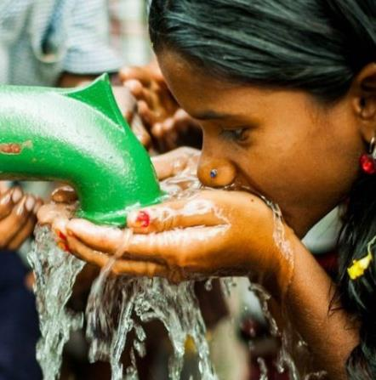
IS BUILDING A BETTER PLANET IMPORTANT TO YOU?
HELP US SHAPE A SUSTAINABLE FUTURE, CHANGING THE WAY THE WORLD DOES BUSINESS!
At Unilever we have a higher purpose, and know that sustainable products are better for our long term growth.
Every one of our Engineers plays a critical part in achieving Unilever’s goal “to make sustainable living commonplace”.
Together, our hands shape a sustainable tomorrow -protecting our people and planet to build a better future.
Notes:
Louise to send link to sustainability images

Slide 8
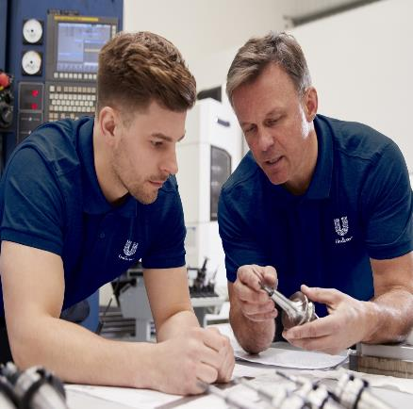
EAGER TO WORK WITH PARTNERS TO DELIVER VALUE?
WE CO-CREATE AND GENERATE INNOVATIVE OPPORTUNITIES THROUGH NEW TECHNOLOGIES AND PEOPLE DEVELOPMENT
Collaborating with strategic partners to develop new technologies and leverage industry wide capabilities. This enables Unilever to be at the forefront of manufacturing through advances in digital, robotics automation, new technology and sustainability.
Partnering to further develop our people via agile opportunities, mentoring and capability development.
Our diversity as people is what makes us stronger. Inclusion for all is what will make us better.
Notes:
Work with partners to deliver value , eager to work with partners to deliver value?
Louise to ask procurement about more pictures

